Slide 1
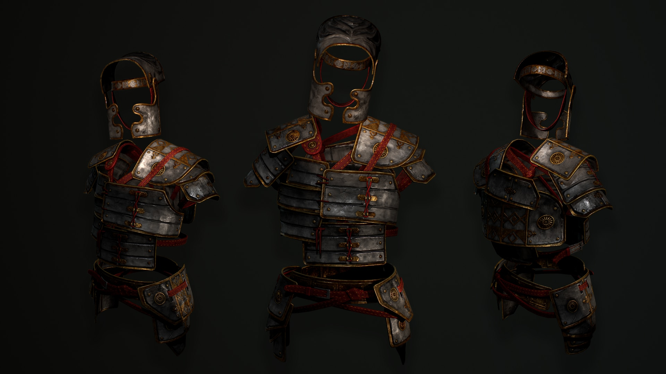
A BATTLE FOR THE
CHRISTIAN HOME
- Praying Always -

Slide 2
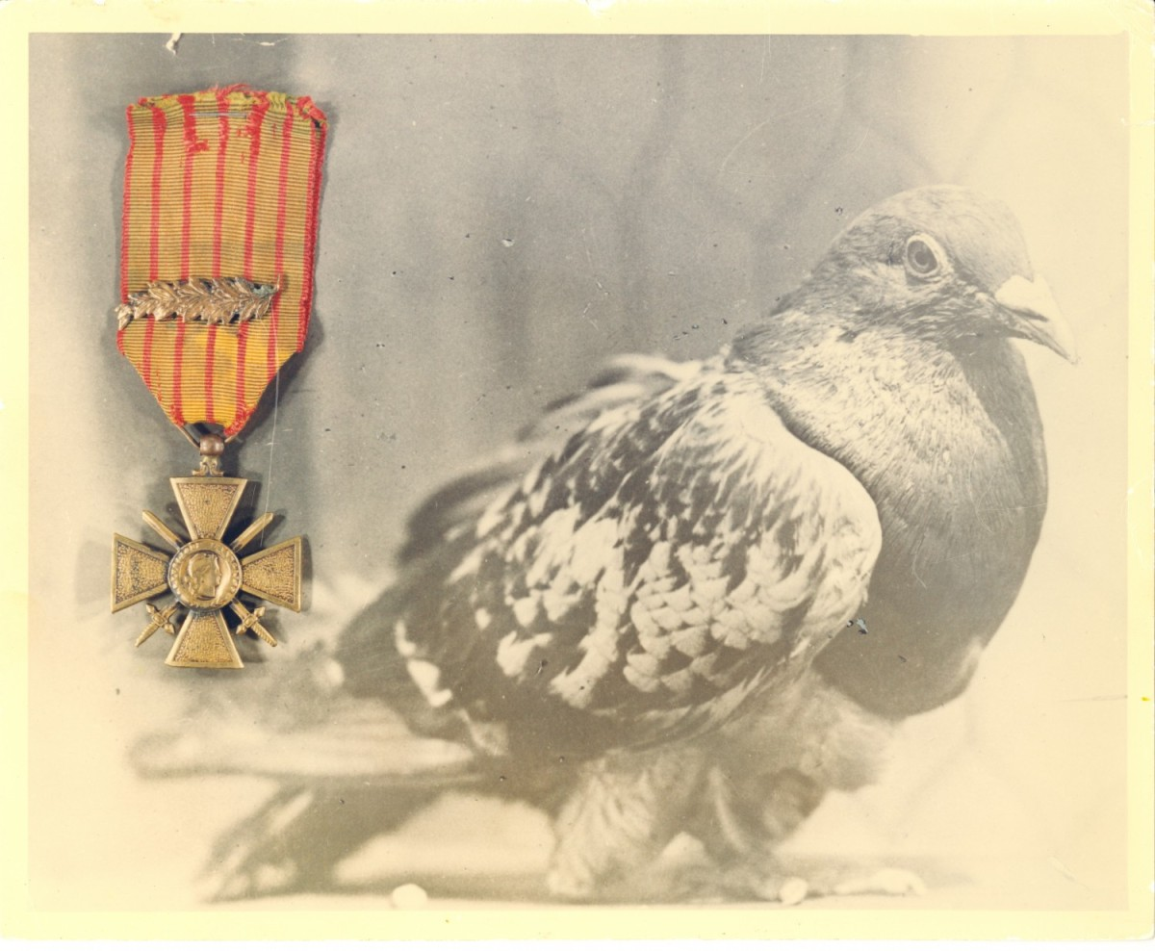
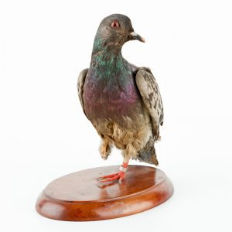
Cher Ami
1918 - 1919

Slide 3
THE PRIMACY
OF PRAYER

Slide 4
THE PRIMACY OF PRAYER
Praying Always

Slide 5
THE PARTS
OF PRAYER

Slide 6
THE PARTS OF PRAYER
Praying

Slide 7
THE PARTS OF PRAYER
Supplication

Slide 8
THE PARTS OF PRAYER
Intercession

Slide 9
THE PERSISTENCE
OF PRAYER

Slide 10
THE PARTNER
OF PRAYER

Slide 11
THE PARTNER OF PRAYER
The Holy Spirit

Slide 12
THE POWER
OF PRAYER

Slide 13
A BATTLE FOR THE
CHRISTIAN HOME

