Slide 1
CONTINUE WITH PREPARATION

Slide 2
PREPARATION OF THE
HEART

Slide 3
David’s Preparation

Slide 4
Solomon’s Preparation

Slide 5
PREPARATION OF THE
MIND

Slide 6
A Willing Mind

Slide 7
A Believing Mind

Slide 8
PREPARATION OF THE
RESOURCES

Slide 9
A Pattern Of The Temple

Slide 10
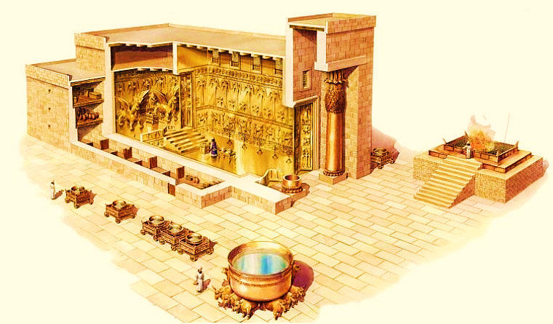
SOLOMON’S TEMPLE

Slide 11
An Offering For The Temple

