Slide 2
THE PROPHECY OF CORRUPTION

Slide 3
The Godly Will Suffer Persecution

Slide 4
The Weak
Will Be Deceived

Slide 5
THE PRIORITY OF
CONTINUING

Slide 6
In Biblical Truth

Slide 7
In Constant Remembrance

Slide 8
In Holy Persistence

Slide 9
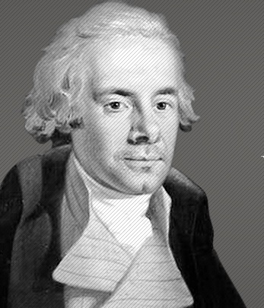
“Our motto must continue to be perseverance. And ultimately I trust the Almighty will crown our efforts with success.”
William Wilberforce
1759 - 1833

Slide 10
THE PATHWAY OF
CONQUEST

Slide 11
The Scriptures Are Profitable

Slide 12
The Scriptures Are Powerful

Slide 13
The Scriptures Are Provisional

