Slide 1
CONTINUE IN HIM

Slide 2
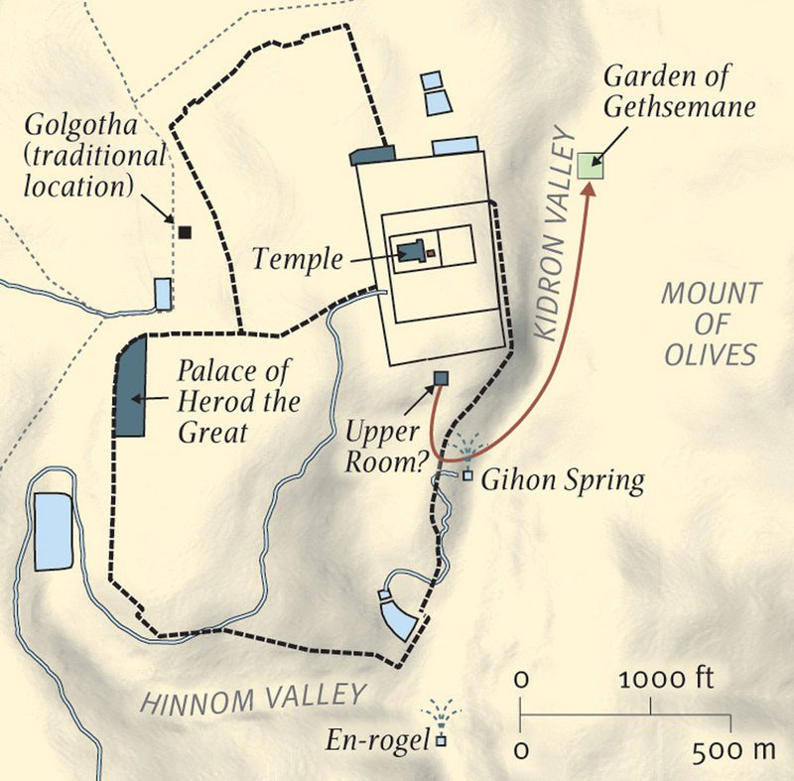
THE KIDRON VALLEY

Slide 3
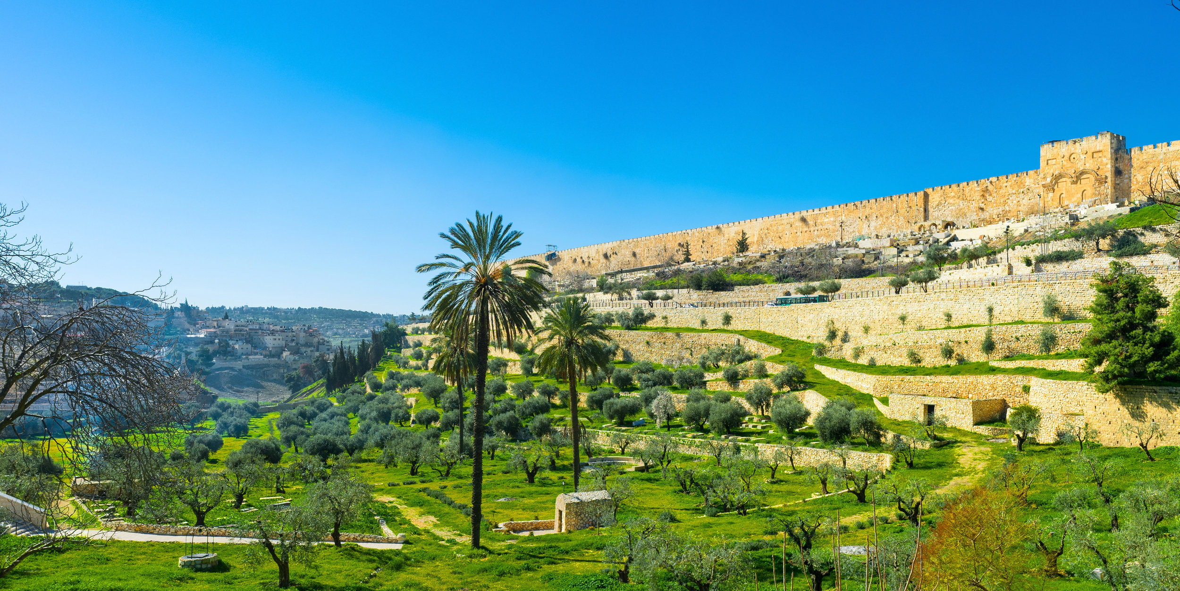
THE KIDRON VALLEY

Slide 4
THE PORTRAYAL
IN THE ABIDING

Slide 5
The True Vine

Slide 6
The Branches

Slide 7
The Husbandman

Slide 8
THE PROCESS
OF THE ABIDING

Slide 9
The Prerequisite

Slide 10
The Pruning

Slide 11
The Purging

Slide 12
The Punishment

Slide 13
THE PRODUCT
OF THE ABIDING

Slide 14
Answered Prayer

Slide 15
Abundant Praise

Slide 16
Adequate Proof

