Slide 1
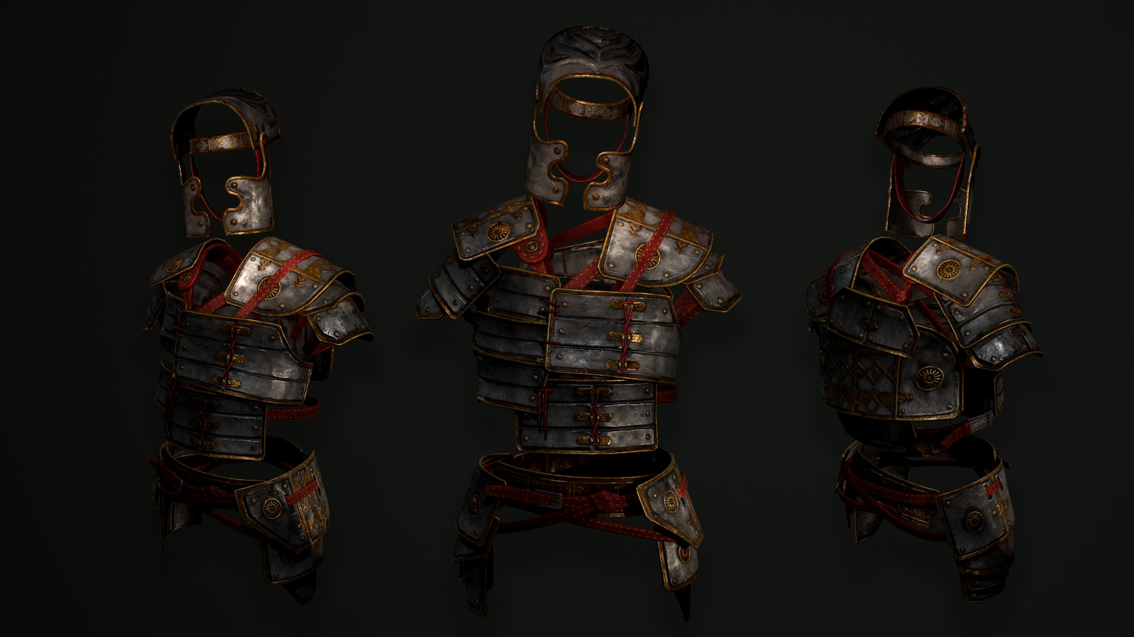
A BATTLE FOR THE
CHRISTIAN HOME
- The Breastplate of Righteousness -

Slide 2
THE ILLUSTRATION

Slide 3
THE ILLUSTRATION
The Roman Centurion

Slide 4
THE ILLUSTRATION
The Breastplate

Slide 5
THE DEFINITION

Slide 6
THE DEFINITION
The Breastplate
of Righteousness

Slide 7
THE APPLICATION

Slide 8
THE APPLICATION
Guard Your Heart

Slide 9
THE APPLICATION
Give Your Heart

Slide 10
A BATTLE FOR THE
CHRISTIAN HOME

