Slide 1
THE
T W E L V E D I S C I P L E S
OF JESUS
Simon Called Zelotes

Slide 2
THE TWELVE DISCIPLES OF JESUS
Simon (Peter)
Andrew
James (the brother of John)
John
Philip
Bartholomew (Nathaniel)
Matthew (Levi)
8. Thomas (Didymus)
James (the son of Alphaeus; also known as James the less)
Simon (called Zelotes)
Judas (Thaddaeus)
Judas Iscariot

Slide 3
THE PLACE OF ZEAL

Slide 4
THE PLACE OF ZEAL
He Brought Enthusiasm
To Their Purpose

Slide 5
THE PRODUCT OF ZEAL

Slide 6
THE PRODUCT OF ZEAL
Provokes Others
To Do Right

Slide 7
THE PROTECTION OF ZEAL

Slide 8
THE PROTECTION OF ZEAL
People Can Hinder You

Slide 9
THE PERFECTION OF ZEAL

Slide 10
THE PERFECTION OF ZEAL
Zeal Is Directed
In The Right Place

Slide 11
THE PERFECTION OF ZEAL
Zeal Is Tempered With
Knowledge And Wisdom

Slide 12
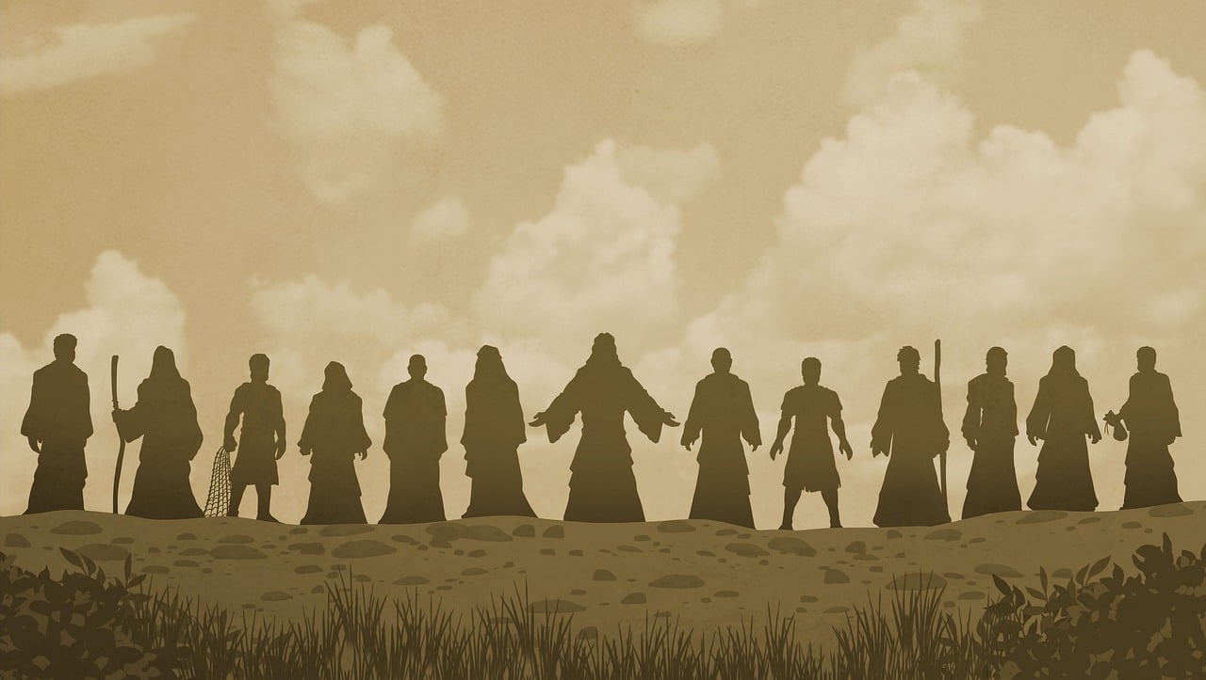
THE
T W E L V E D I S C I P L E S
OF JESUS

